Slide 1
Mini-module 3: Waves, Energy, and Light

Slide 2

Mini module 3: Color and Waves
Learning Outcomes:
HS-PS3-1 Create a computational model to calculate the change in the energy of one component in a system when the change in energy of the other component(s) and energy flows in and out of the system are known.
HS-PS4-1. Use mathematical representations to support a claim regarding relationships among the frequency, wavelength, and speed of waves traveling in various media.
HS-PS4-4. Evaluate the validity and reliability of claims in published materials of the effects that different frequencies of electromagnetic radiation have when absorbed by matter.
This material was developed as part of a grant received from the National Science Foundation, Award Number 1905734
Notes:
Resources:
https://blog.feslighting.com/incandescent-vs-led#:~:text=LEDs%20operate%20at%20an%20impressive,only%2010%2D20%25%20efficient.
https://www.thelightbulb.co.uk/resources/ultimate-guide-led-lights-leds-vs-incandescent-lights/
https://cen.acs.org/materials/inorganic-chemistry/chemical-search-better-white-light/96/i46
Relevant Objectives: https://www.nextgenscience.org/topic-arrangement/hsenergy
https://www.nextgenscience.org/topic-arrangement/hswaves-and-electromagnetic-radiation

Slide 3
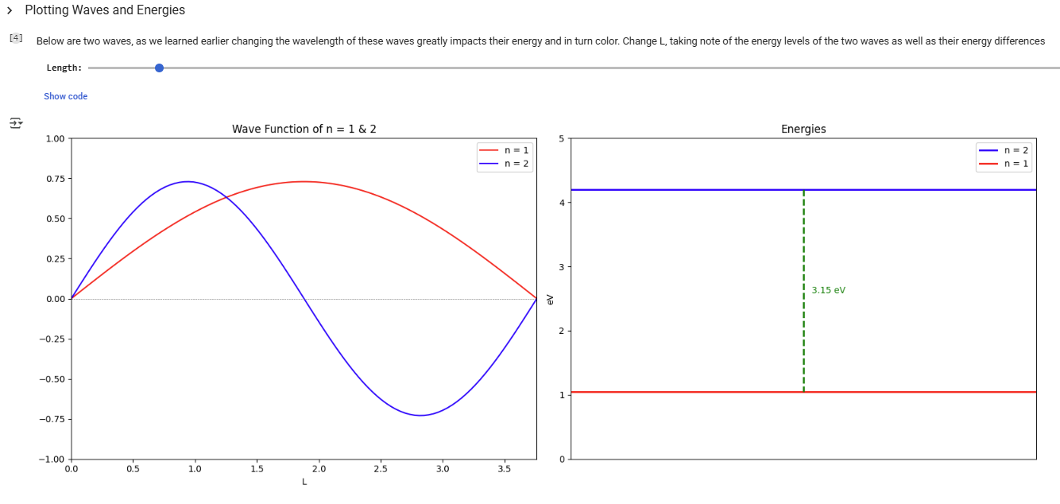
Online Lesson
Waves, Energy and Color Model: (moving to Kaggle?)
https://github.com/megan-r-brown/Exploring-the-role-of-Materials-Chemistry-Biology-and-Electronics-in-Smartphones

Slide 4
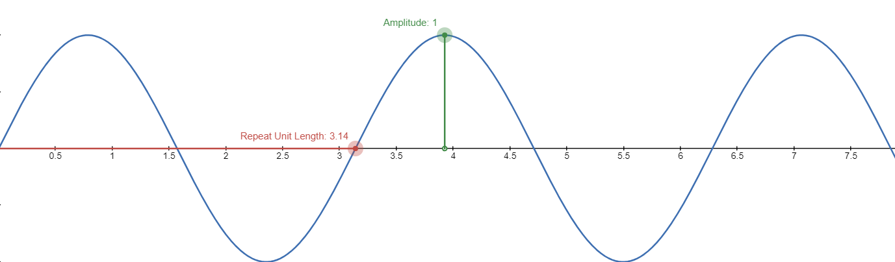
What defines a wave?
Amplitude:
The “size” of a wave
Wavelength:
How long it takes for the wave to repeat
Play with waves yourself
Notes:
More applets: https://phet.colorado.edu/sims/html/wave-on-a-string/latest/wave-on-a-string_all.html

Slide 5
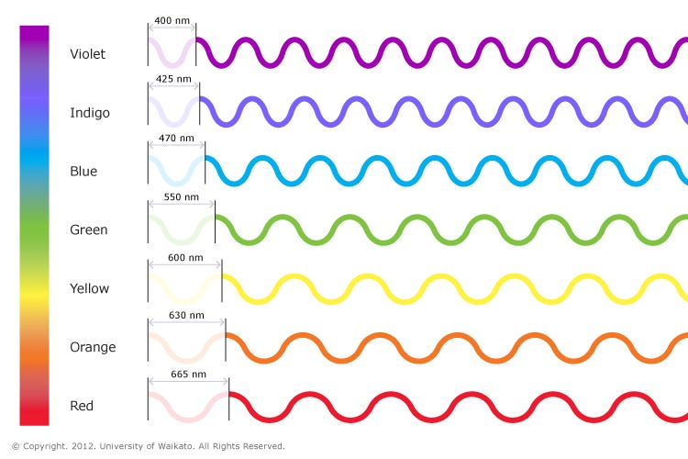
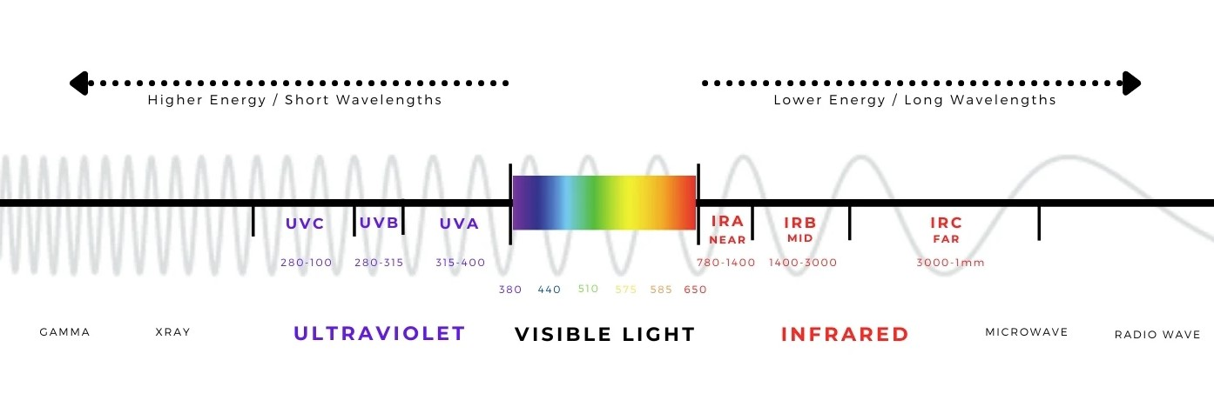
Color and Wavelength
Wavelength is the only determining factor in the color we see
As the wavelength gets longer the color becomes more and more red
As the wavelength gets longer the energy decreases (referred to as red shifting)

Slide 6
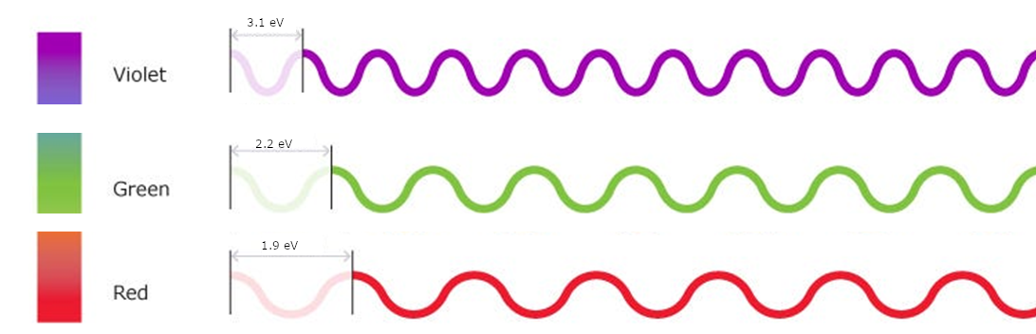
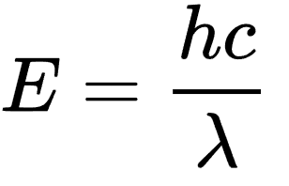
Color, Wavelength and Energy
Wavelength (λ)
Energy (eV)
Planck's Constant: h = 6.5 * 10⁻¹⁶ eV*s
Speed of Light: c = 3 * 10⁸ m*s⁻¹
λ(Lamda ) = Wavelength (m)

Slide 7


Electrons Emit Light When They Lose Energy
e⁻
The amount of energy lost determines the color!
+
e⁻

Slide 8
Example questions
https://colab.research.google.com/drive/1u6ndeCskxhfThumCNgOqATr6340i3fIE
Red in a cell phone display has 650 nm wavelength. How much energy did the electron need to lose to emit that color?
Blue in a cell phone display has 400 nm wavelength. What is the energy associated with this wavelength?
A colored flashlight burns 2.5 eV of energy. What is the wavelength and color?
Notes:
https://colab.research.google.com/drive/1u6ndeCskxhfThumCNgOqATr6340i3fIE

